Slide 1
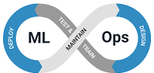
MLOps Process to manage full lifecycle for a Large Language Model management

Slide 2

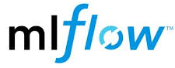






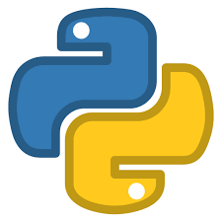




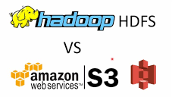
MLOps Process Overview
Data Transformation
Model Registry
Model Evaluation
Process Performance & Improvements
Data Ingestion
Commit the Code
Model Training & Model Engineering
ETL /Data Pipeline
Cloud Resourcing
Model Containerization
e.g. EKS
Push the image to Hub
Data Storage
Model Deployment
Cluster Structure
Namespaces / Replicas
Deployment & Service
CI / CD Build Stage

Slide 3

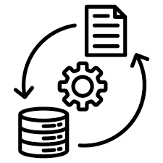
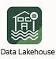




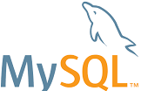






Step 1 – Automate Data Pipelines & Transformation Process
Option 1
Data at source
Option 2
Container_1
Container_2
def extract_data_to_s3():
def clean_data_w_spark():
Namespace : “ETL-Process”
Master Node
Worker Node
Pod_1
Pod_2
Pod_3

Slide 4

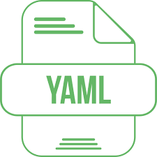
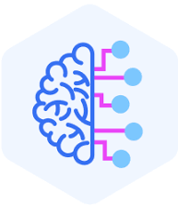
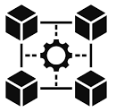


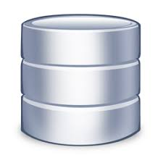


Step 2 – Building, Testing & Deploying the model manually
From Step 1 - Create K8s Set-up
Model Building
Model Deployment
Data Tests
Kind: Cluster
VPC: 192.84.13.1
Nodes: 4
Autoscaling :
Volume
ML Infrastructure
Running System
User Inputs a query
Code
Model Test
Unit Tests
1
Integration Tests
Namespace Creation
Kind: namespace
Metadata:
name:kubeflow
Query is converted to Embeddings using an open-source Transformer
Model Registry
Step 1 – Data Extraction and Transformation via Kubeflow route
Deply Kubeflow
Deploy Kubeflow at the Cluster level
5
4
2
Model Registry
1. Data Extraction
2. Data Transform
3. Data storage
Decode Embeddings to human readable format
Model Containerization
Deploy Pods
Database returns Semantic Embeddings
Create Deployment & Service YAML files
Semantically query the database
6
3
Deployment
Define Kubeflow Pipeline and deploy everything
@dsl.pipeline
(
name: ,
desc: )
Output is served to the user
Pods
Pods
Pods
Pods
Service

Slide 5



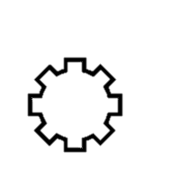

Step 3 – Automation… (CI / CD Pipeline)
Level of automation of Data, ML Model, & Code pipelines determines the maturity of the ML process.
Checkout Branch
Merge Branch & Auto Deploy
Main
Commit Changes
Open Pull Requests
Approve pull request
Testing
Y
Development
Pass
N
.github/workflows
.Ci-CD Pipeline.yml
DockerFile
Deployment.yml
Commit Fixes
.Service.yml
AI / ML model.py
Requirements.txt

